Slide 1
Prometheus

Slide 2
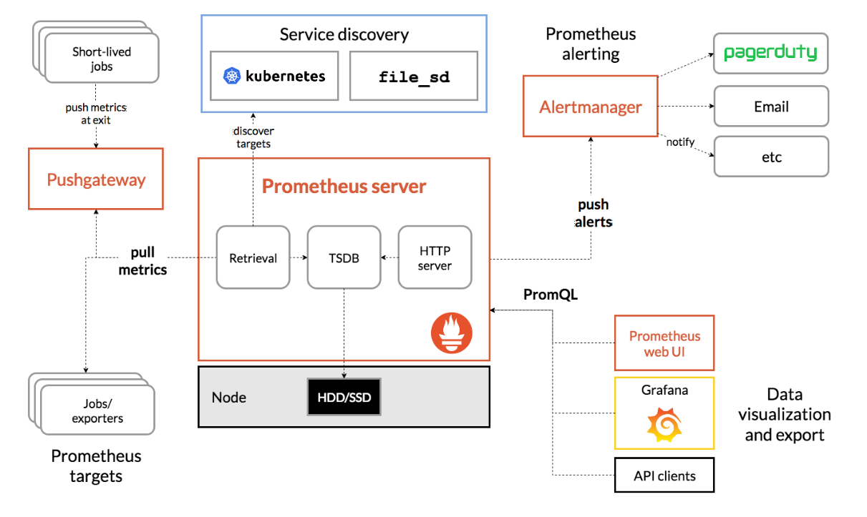

Slide 3
Metric output
process_cpu_seconds_total{instance="localhost:9090", job="prometheus"}

Slide 4
Out the box metrics
Counter
Gauge
Histogram
Summary

